Slide 1

Delivering the LES for trans patients
sophie.quinney2@wales.nhs.uk

Slide 2
Covered this afternoon
Hormone therapies
History of trans healthcare, and the new Welsh pathway
Trans identities and inclusive practice
Sexual health, contraception, and screening
Initiating and monitoring patients
Long term care and the DES

Slide 3
Learning objectives
Familiarity with HRT
Appreciation of trans healthcare evolution
Improved comfort with language and consulting
..and check in on sexual health
Confidence to initiate treatment
..and deliver good quality lifespan care

Slide 4

Healthcare history
Conversion/aversion therapy, psychoanalysis
Affirmative (‘cross sex’) hormone therapy, 1960s
Categorized as mental health disorder until ICD-11, 2020
New diagnostic term: Gender Incongruence
Still the realm of ‘specialist’ clinics staffed by psychiatrists

Slide 5
Healthcare history, Wales
Until 2017, mandatory physical exam and karyotype test
Until 2019, mandatory assessment by a psychiatrist
Young people, ongoing requirement for CAMHS
Post code lottery for endorsed hormones until 2019
Endorsements for adults now from Cardiff, surgeons in England

Slide 6
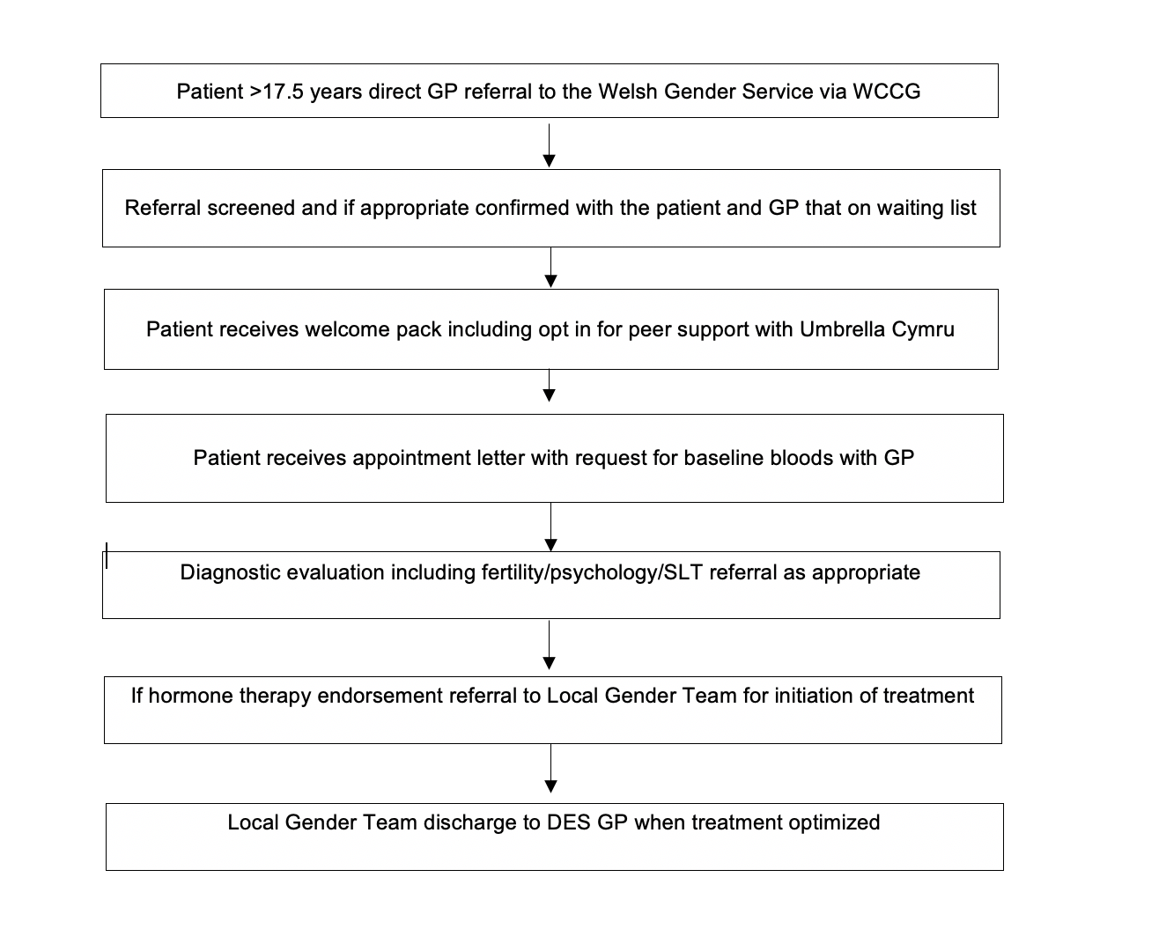
The new Welsh pathway
Waiting times 2+ years
Signposting important
Refer for vocal exploration (SLT)
Facial hair removal not currently funded by NHSW
Consider menstrual suppression
Report self-medication, endemic in UK due to long waits

Slide 7
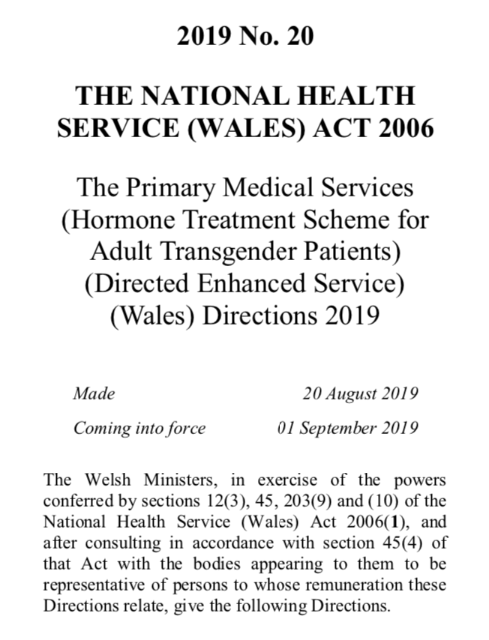
Enhanced Service
A first in the UK
Ensures GPs are compensated
Provides payment to support learning
Started as a DES for maintenance prescribing once initiated by the local gender team
Some LHBs developed a LES which also accommodates GPs initiating HRT
Service commitment to support all GP enquiries cav.wgs@wales.nhs.uk

Slide 8

Trans identities and inclusive practice
“
Gender diversity is human diversity
Trans man – AFAB
Trans woman – AMAB
Non-binary trans feminine (AMAB)
Non-binary trans masculine (AFAB)

Slide 9

Consulting well
Non-verbal communication
Adjust consultation style to fit with neurodiversity
Telephone – assumptions re vocal pitch
Name and pronouns are important
Assume nothing and ask if not sure
If you make a mistake, apologize and move on

Slide 10

Delivering the LES: a surgery-wide approach to inclusivity
Awareness training for allied staff
Fire walls and safe communication
Call handling
Waiting room environment and facilities
Changing health records
Read codes for audit vs privacy
Screening alerts

Slide 11
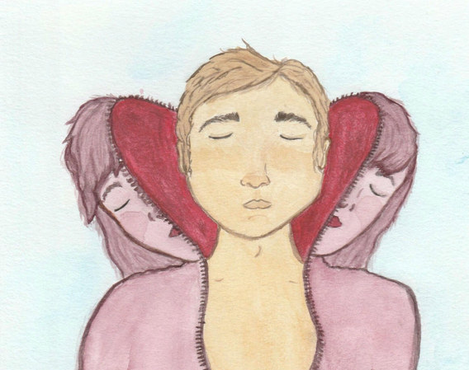
Hormone therapies for trans people
Broad aim to suppress endogenous system and replace with cross-sex hormone
Dosing according to a target range
Standard formulations all used in cis gender pop.
Well-established globally https://academic.oup.com/jcem/article/102/11/3869/4157558
Low risk treatments, minimal SEs
Usually used life-long

Slide 12
Prescribing guidance for Wales
AWMSG guidance for the non-specialist 2019
UK-wide consultation
Aim to simplify. inc. flow charts
Standardized regimens
Publicly available https://awmsg.nhs.wales/medicines-appraisals-and-guidance/medicines-optimisation/prescribing-guidance/endocrine-management-of-gender-dysphoria-in-adults/

Slide 13
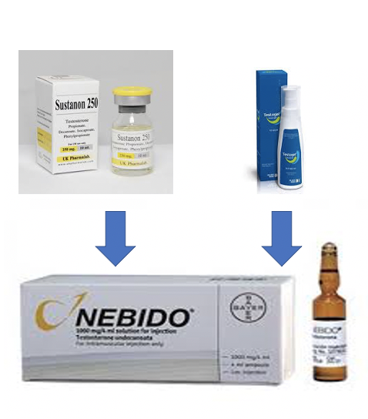
Testosterone overview
Topical or injectable
Testogel 16.2mg/g gel – 20mg per actuation
Tostran 2% gel – 10mg per actuation
Testavan gel – 23mg per actuation
Sustanon /Delatestryl – short acting – nut/sesame
Nebido – long acting - caster oil
Preference for gel then Nebido, if desired
Notes:
Quantitatively, estrogens circulate at lower levels than androgens in both men and women.^{[3]} While estrogen levels are significantly lower in males compared to females, estrogens nevertheless have important physiological roles in males
The four major naturally occurring estrogens in women are estrone (E1), estradiol (E2), estriol (E3), and estetrol (E4). Estradiol is the predominant estrogen during reproductive years both in terms of absolute serum levels as well as in terms of estrogenic activity. During menopause, estrone is the predominant circulating estrogen and during pregnancy estriol is the predominant circulating estrogen in terms of serum levels. Given by subcutaneous injection in mice, estradiol is about 10-fold more potent than estrone and about 100-fold more potent than estriol.^{[9]} Thus, estradiol is the most important estrogen in non-pregnant females who are between the menarche and menopause stages of life. However, during pregnancythis role shifts to estriol, and in postmenopausal women estrone becomes the primary form of estrogen in the body. Another type of estrogen called estetrol(E4) is produced only during pregnancy. All of the different forms of estrogen are synthesized from androgens, specifically testosterone and androstenedione, by the enzyme aromatase. Like all steroid hormones, estrogens readily diffuse across the cell membrane. Once inside the cell, they bind to and activate estrogen receptors (ERs) which in turn modulate the expression of many genes.

Slide 14
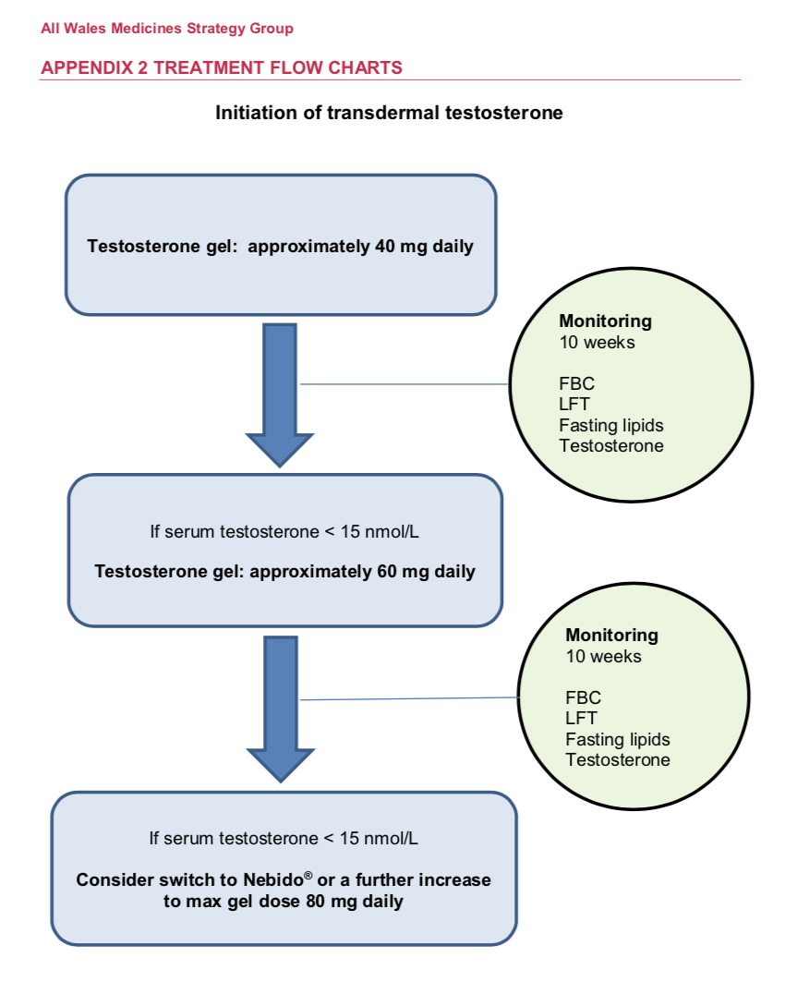
Testosterone gels
Standardized schedule
Testogel 16.2mg/g, 2 pumps daily
Thigh application
Blood testing 4-6 hours post-application
Target serum testosterone = 15-20 nmol/l
Lower dose regime - Tostran 2%
Notes:
Quantitatively, estrogens circulate at lower levels than androgens in both men and women.^{[3]} While estrogen levels are significantly lower in males compared to females, estrogens nevertheless have important physiological roles in males
The four major naturally occurring estrogens in women are estrone (E1), estradiol (E2), estriol (E3), and estetrol (E4). Estradiol is the predominant estrogen during reproductive years both in terms of absolute serum levels as well as in terms of estrogenic activity. During menopause, estrone is the predominant circulating estrogen and during pregnancy estriol is the predominant circulating estrogen in terms of serum levels. Given by subcutaneous injection in mice, estradiol is about 10-fold more potent than estrone and about 100-fold more potent than estriol.^{[9]} Thus, estradiol is the most important estrogen in non-pregnant females who are between the menarche and menopause stages of life. However, during pregnancythis role shifts to estriol, and in postmenopausal women estrone becomes the primary form of estrogen in the body. Another type of estrogen called estetrol(E4) is produced only during pregnancy. All of the different forms of estrogen are synthesized from androgens, specifically testosterone and androstenedione, by the enzyme aromatase. Like all steroid hormones, estrogens readily diffuse across the cell membrane. Once inside the cell, they bind to and activate estrogen receptors (ERs) which in turn modulate the expression of many genes.

Slide 15
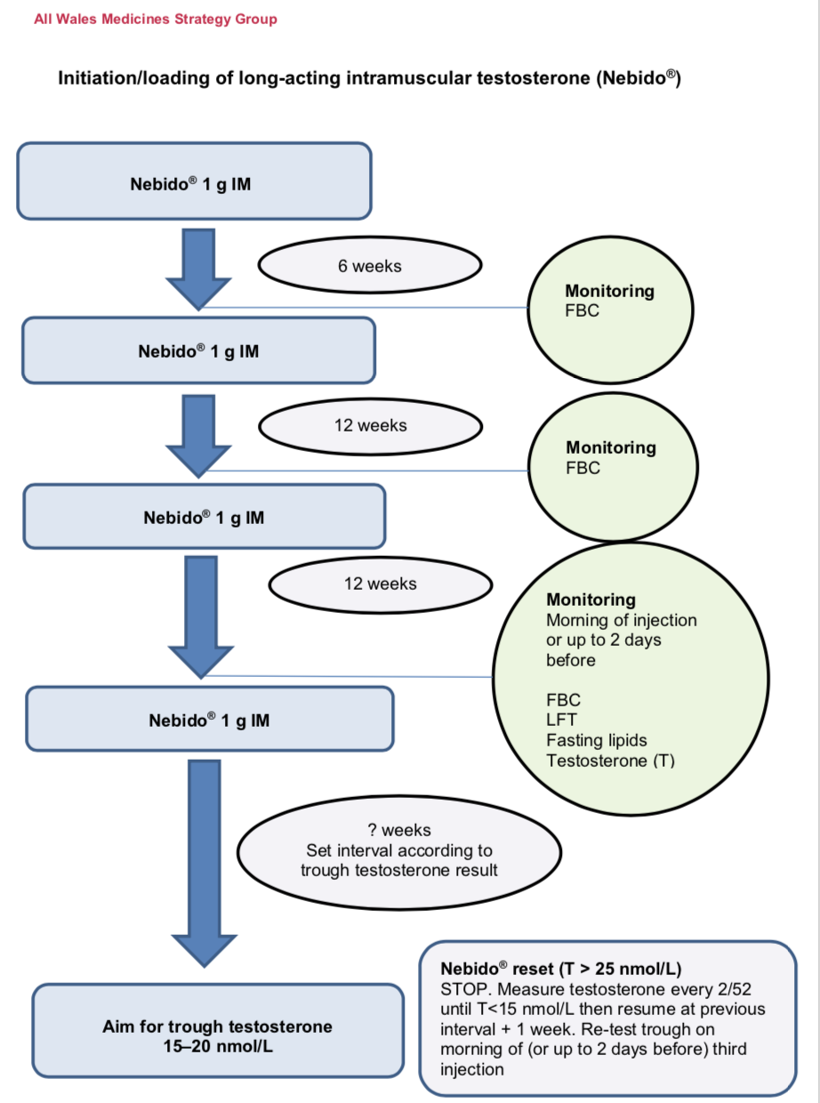
Testosterone by injection
Typically switch to Nebido after trial with gel
Straight forward loading schedule
Dose fixed at Nebido 1g
Typical interval is 12-14 weeks
Testing always on day of, or up to 2 days before inj.
Target trough testosterone = 15-20 nmol/l
Notes:
Quantitatively, estrogens circulate at lower levels than androgens in both men and women.^{[3]} While estrogen levels are significantly lower in males compared to females, estrogens nevertheless have important physiological roles in males
The four major naturally occurring estrogens in women are estrone (E1), estradiol (E2), estriol (E3), and estetrol (E4). Estradiol is the predominant estrogen during reproductive years both in terms of absolute serum levels as well as in terms of estrogenic activity. During menopause, estrone is the predominant circulating estrogen and during pregnancy estriol is the predominant circulating estrogen in terms of serum levels. Given by subcutaneous injection in mice, estradiol is about 10-fold more potent than estrone and about 100-fold more potent than estriol.^{[9]} Thus, estradiol is the most important estrogen in non-pregnant females who are between the menarche and menopause stages of life. However, during pregnancythis role shifts to estriol, and in postmenopausal women estrone becomes the primary form of estrogen in the body. Another type of estrogen called estetrol(E4) is produced only during pregnancy. All of the different forms of estrogen are synthesized from androgens, specifically testosterone and androstenedione, by the enzyme aromatase. Like all steroid hormones, estrogens readily diffuse across the cell membrane. Once inside the cell, they bind to and activate estrogen receptors (ERs) which in turn modulate the expression of many genes.

Slide 16
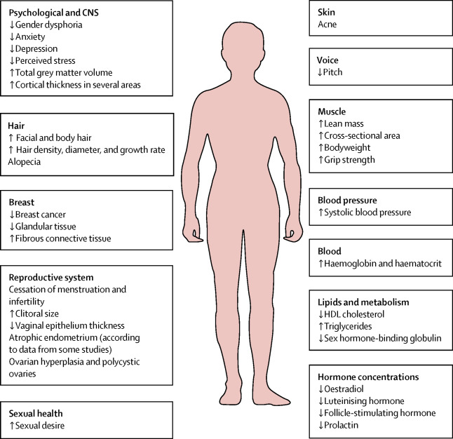
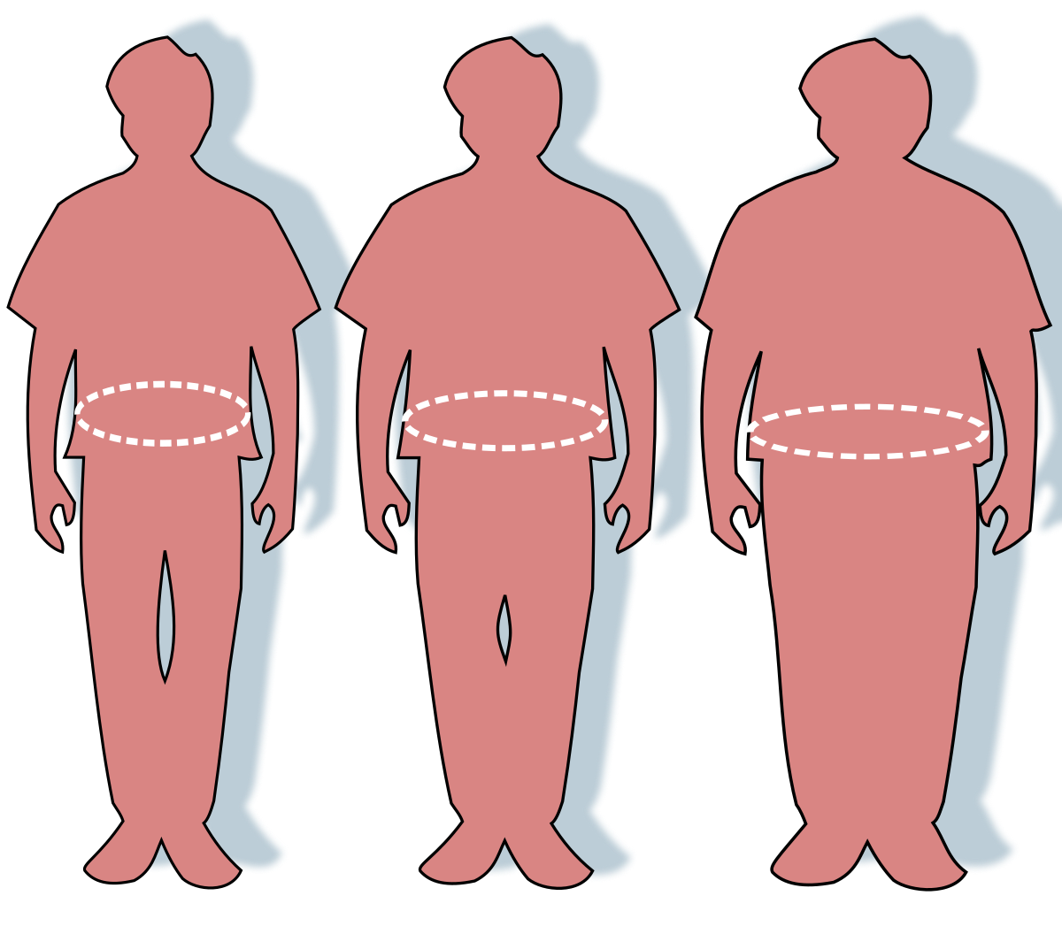

Manifestations of male puberty
Notes:
HOT HORNY HUNGRY
HAIRY, HOARSE
HUNKY
Permanent: facial hair, voice, clitoral growth
?impact on ova
Estradiol in men is essential for modulating libido, erectile function, and spermatogenesis.

Slide 17
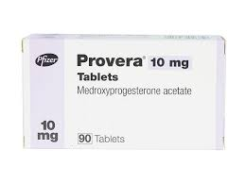
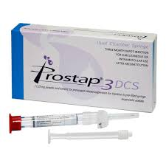
Adjunctive treatments for AFAB : menstrual cessation
Language: “bleeds”, follow patient
Most people happy to let testosterone work
Others: Provera 10mg BD/TDS – once T>10nmol/l , withdraw
Check if need ongoing contraception, progesterone-based
Persistent cyclical pains – GnRHa as for endometriosis
Bleeding re-starts? Check T levels, if in range inv. as unexplained
NB on low dose regime – start oral Provera then IUS/Depot MPA
Notes:
Quantitatively, estrogens circulate at lower levels than androgens in both men and women.^{[3]} While estrogen levels are significantly lower in males compared to females, estrogens nevertheless have important physiological roles in males
The four major naturally occurring estrogens in women are estrone (E1), estradiol (E2), estriol (E3), and estetrol (E4). Estradiol is the predominant estrogen during reproductive years both in terms of absolute serum levels as well as in terms of estrogenic activity. During menopause, estrone is the predominant circulating estrogen and during pregnancy estriol is the predominant circulating estrogen in terms of serum levels. Given by subcutaneous injection in mice, estradiol is about 10-fold more potent than estrone and about 100-fold more potent than estriol.^{[9]} Thus, estradiol is the most important estrogen in non-pregnant females who are between the menarche and menopause stages of life. However, during pregnancythis role shifts to estriol, and in postmenopausal women estrone becomes the primary form of estrogen in the body. Another type of estrogen called estetrol(E4) is produced only during pregnancy. All of the different forms of estrogen are synthesized from androgens, specifically testosterone and androstenedione, by the enzyme aromatase. Like all steroid hormones, estrogens readily diffuse across the cell membrane. Once inside the cell, they bind to and activate estrogen receptors (ERs) which in turn modulate the expression of many genes.

Slide 18
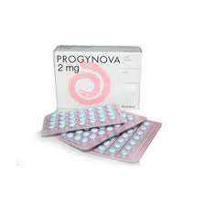
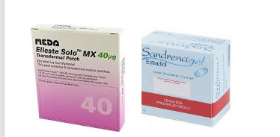
Estrogen overview
Usually oral unless risk
Patch and gel alternatives
“clean” estradiol only
Switch to topicals:
Menopausal age
New medical risk
Subtherapeutic levels (first pass metabolism)
Notes:
Quantitatively, estrogens circulate at lower levels than androgens in both men and women.^{[3]} While estrogen levels are significantly lower in males compared to females, estrogens nevertheless have important physiological roles in males
The four major naturally occurring estrogens in women are estrone (E1), estradiol (E2), estriol (E3), and estetrol (E4). Estradiol is the predominant estrogen during reproductive years both in terms of absolute serum levels as well as in terms of estrogenic activity. During menopause, estrone is the predominant circulating estrogen and during pregnancy estriol is the predominant circulating estrogen in terms of serum levels. Given by subcutaneous injection in mice, estradiol is about 10-fold more potent than estrone and about 100-fold more potent than estriol.^{[9]} Thus, estradiol is the most important estrogen in non-pregnant females who are between the menarche and menopause stages of life. However, during pregnancythis role shifts to estriol, and in postmenopausal women estrone becomes the primary form of estrogen in the body. Another type of estrogen called estetrol(E4) is produced only during pregnancy. All of the different forms of estrogen are synthesized from androgens, specifically testosterone and androstenedione, by the enzyme aromatase. Like all steroid hormones, estrogens readily diffuse across the cell membrane. Once inside the cell, they bind to and activate estrogen receptors (ERs) which in turn modulate the expression of many genes.

Slide 19
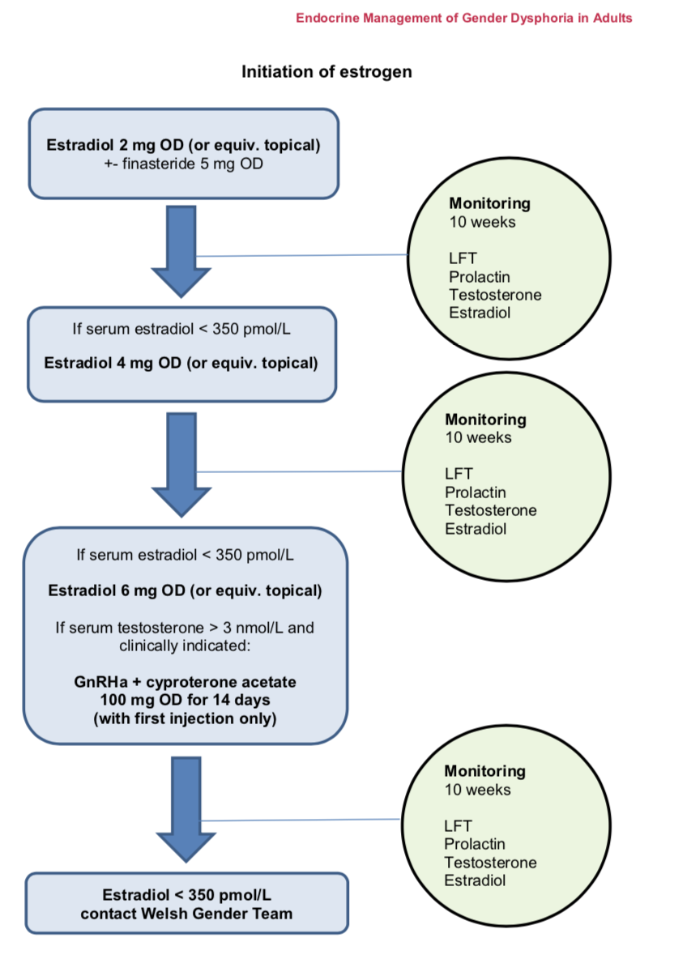
Estrogen titration
Oral titration 2mg > 4mg > 6mg
Gel titration 1mg > 2mg > 3mg
Patch titration 50mcg > 100mcg > 150mcg
Target range = serum estradiol 350-750pmol/l
Up to 750pmol/l for puberty induction
350pmol/l post-puberty for long term maintenance
Bloods 4-6hrs after tablets taken or gel applied
Bloods 48hrs after patch changed
Notes:
Quantitatively, estrogens circulate at lower levels than androgens in both men and women.^{[3]} While estrogen levels are significantly lower in males compared to females, estrogens nevertheless have important physiological roles in males
The four major naturally occurring estrogens in women are estrone (E1), estradiol (E2), estriol (E3), and estetrol (E4). Estradiol is the predominant estrogen during reproductive years both in terms of absolute serum levels as well as in terms of estrogenic activity. During menopause, estrone is the predominant circulating estrogen and during pregnancy estriol is the predominant circulating estrogen in terms of serum levels. Given by subcutaneous injection in mice, estradiol is about 10-fold more potent than estrone and about 100-fold more potent than estriol.^{[9]} Thus, estradiol is the most important estrogen in non-pregnant females who are between the menarche and menopause stages of life. However, during pregnancythis role shifts to estriol, and in postmenopausal women estrone becomes the primary form of estrogen in the body. Another type of estrogen called estetrol(E4) is produced only during pregnancy. All of the different forms of estrogen are synthesized from androgens, specifically testosterone and androstenedione, by the enzyme aromatase. Like all steroid hormones, estrogens readily diffuse across the cell membrane. Once inside the cell, they bind to and activate estrogen receptors (ERs) which in turn modulate the expression of many genes.

Slide 20

Anti-androgens: individualizing care
Estrogen alone usually insufficient in fully suppressing T
T = androgenic alopecia, sweat, scent, libido, body hair
Not much of a middle ground re UK options
Self-med: spironolactone, cyproterone acetate, bicalutamide
Finasteride – mild, oral. Blocks DHT. SEs inc. gynecomastia, libido reduction, low mood. Scalp hair protection 2.5mg
GnRHa – injectable, usually 12/52. Efficacious so starts later. Check QTi if polypharmacy. Genital impact.
Notes:
5-alpha reductase inhibitors include finasteride and dutasteride. Finasteride blocks 5-alpha reductase type 2 and 3 mediated conversion of testosterone to the potent androgen dihydrotestosterone.[8] Finasteride 1mg daily is FDA-approved for male pattern baldness, while the 5mg dose is approved for management of prostatic hypertrophy.[9] Dutasteride 0.5mg more effectively blocks the type 1 isozyme, which is present in the pilosebaceous unit and therefore may have more dramatic feminizing effects. Since these medications block neither the production nor action of testosterone, their antiandrogen effect is less than that encountered with full blockade

Slide 21
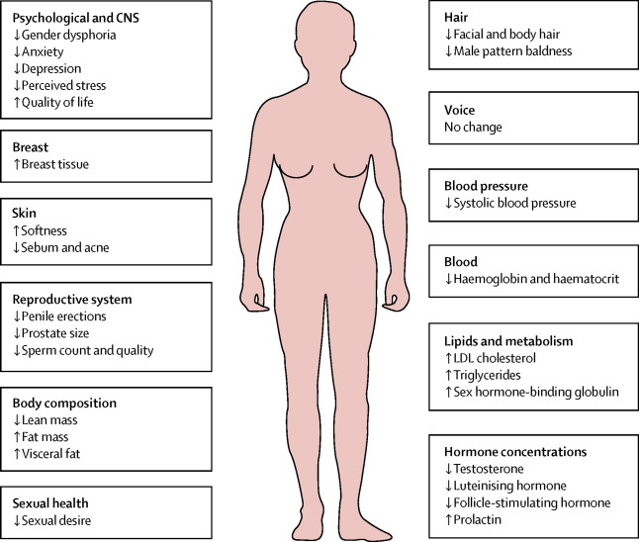


Manifestations of female puberty
Notes:
Permanent : breast growth
No impact : facial hair, voice

Slide 22
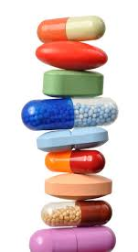
Tailor-made regimes for alternative outcomes
Alternative outcome not just about non-binary
AFAB NB trans masculine – ”no T” versus “low T”
Extent of virilization highly variable
Social navigation – living in a binary world
Not all trans women want GRS – consider sexual function
AMAB NB trans feminine – antiandrogen +/- “low dose” estrogen
Bone health
Notes:
FOR ANTI-ANDROEGN ALONE:
In the absence of estrogen replacement, some patients may have unpleasant symptoms of hot flashes and low mood or energy. Long term full androgen blockade without hormone replacement in men who have undergone treatment for prostate cancer results in bone loss, and this effect would also be expected to occur in transgender individuals.
monitoring hormone levels to ensure suppressed gonadotropins (luteinizing hormone [LH] and follicle stimulating hormone [FSH]) levels may serve as a surrogate marker to indicate adequate sex hormone levels for maintaining bone density in such patients

Slide 23
Role of the LES GP: receiving a patient
Read the clinic letter plan
Are they endorsed to start HRT?
Are they undertaking fertility preservation?
Are they first being reviewed by the WGS endocrinologist?
Check medical Hx, medications and smoking status
Review baseline bloods or request if not done
Are any further investigations needed based on the above?
Offer suitably-timed appointment

Slide 24
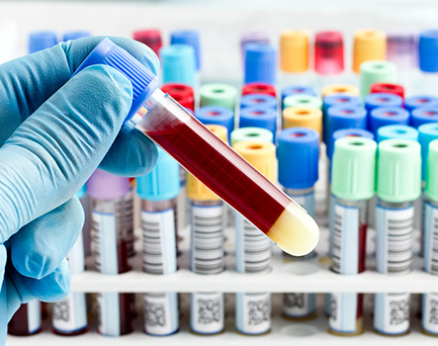
Reviewing bloods : baselines
FBC, renal, lipids, LFT, HbA1c, prolactin, Vit D, (PSA)
LH, FSH, SHBG, testosterone and estradiol
check what reference range has been applied
hormone axis fluctuates with cycle if AFAB
hormone axis impacted by self-medication
not sure? Endocrine.cav.wgs@wales.nhs.uk
Notes:
FOR ANTI-ANDROEGN ALONE:
In the absence of estrogen replacement, some patients may have unpleasant symptoms of hot flashes and low mood or energy. Long term full androgen blockade without hormone replacement in men who have undergone treatment for prostate cancer results in bone loss, and this effect would also be expected to occur in transgender individuals.
monitoring hormone levels to ensure suppressed gonadotropins (luteinizing hormone [LH] and follicle stimulating hormone [FSH]) levels may serve as a surrogate marker to indicate adequate sex hormone levels for maintaining bone density in such patients

Slide 25
Role of the LES GP: receiving a patient
Check patient has read hormone info, signed consent form and is ready to start
Discuss regime
Testogel - comfortable with 2 pumps?
Estrogen - Progynova 2mg
Antiandrogen wanted? - Finasteride 5mg

Slide 26
Role of the LES GP: receiving a patient
Give 3-month supply of medication
Give blood form for 10 weeks, explain timings
Give appointment for 12-week review

Slide 27


Role of the LES GP: first review
For all patients:
general wellbeing
physical and emotional changes
compliance / SEs
bloods review and check timing of HRT

Slide 28

Role of the LES GP: first review
For non-binary patients, if bloods okay and not smoking:
continue with hormone regime as directed by the WGS letter
this may or may not involve upward titration
give 3/12 supply and blood form and book 12/52 review

Slide 29
Role of the LES GP: first review
For trans men, if bloods okay and not smoking:
offer Nebido loading. Gel usually continues for 14 days following first injection
gel can continue if preferred, dose adjusted as per serum testosterone. Give 3/12 supply and blood form and book for 12/52 phone call

Slide 30
Role of the LES GP: first review
For trans women, if bloods okay, not smoking, and happy to continue:
titrate up estrogen as per flow chart e.g.: Progynova 4mg
continue finasteride, if using and no SEs
give 3/12 supply and blood form and book 12/52 review
Notes:
Transition Hx **IN THE CONTEXT OF THEIR PRESENTING COMPLAINT ONLY***
PMH – any surgeries?
DH – will offer up HRT
ALWAYS: Be able to back up why you are asking a particular question
**WHY ASKING ABOUT MEDS PRESCRIBED OR OTHERWISE?”
**WHAT IS TRANS BROKEN ARM?**
The phenomenon when healthcare providers assume that all medical issues are a result of a person being trans
Payton 2015

Slide 31
Role of the LES GP: second review
For trans women, if bloods okay, not smoking, and happy to continue:
titrate up estrogen as per flow chart, e.g.: Progynova 6mg
offer for GnRha to start
continue finasteride at half dose, if needed
give 3/12 script and blood form and 12/52 review
Notes:
Transition Hx **IN THE CONTEXT OF THEIR PRESENTING COMPLAINT ONLY***
PMH – any surgeries?
DH – will offer up HRT
ALWAYS: Be able to back up why you are asking a particular question
**WHY ASKING ABOUT MEDS PRESCRIBED OR OTHERWISE?”
**WHAT IS TRANS BROKEN ARM?**
The phenomenon when healthcare providers assume that all medical issues are a result of a person being trans
Payton 2015

Slide 32
GnRha administration
required particularly if wanting GRS
usually starts once serum oestradiol > 200 pmol/l
ECG to check QTi if indicated
Prostap – small needle and easy to administer
give Cyproterone acetate with first injection only
12-weekly
Notes:
Transition Hx **IN THE CONTEXT OF THEIR PRESENTING COMPLAINT ONLY***
PMH – any surgeries?
DH – will offer up HRT
ALWAYS: Be able to back up why you are asking a particular question
**WHY ASKING ABOUT MEDS PRESCRIBED OR OTHERWISE?”
**WHAT IS TRANS BROKEN ARM?**
The phenomenon when healthcare providers assume that all medical issues are a result of a person being trans
Payton 2015

Slide 33
Reviewing bloods : monitoring
Testosterone
Will raise HCt, esp. smoking. Report > 0.52
Might raise TG and lower HDL
Estrogens
Will raise prolactin. Report > 1000
Might lower testosterone
Want advice? cav.wgs@wales.nhs.uk
Notes:
FOR ANTI-ANDROEGN ALONE:
In the absence of estrogen replacement, some patients may have unpleasant symptoms of hot flashes and low mood or energy. Long term full androgen blockade without hormone replacement in men who have undergone treatment for prostate cancer results in bone loss, and this effect would also be expected to occur in transgender individuals.
monitoring hormone levels to ensure suppressed gonadotropins (luteinizing hormone [LH] and follicle stimulating hormone [FSH]) levels may serve as a surrogate marker to indicate adequate sex hormone levels for maintaining bone density in such patients

Slide 34

Sexual health : overview
“ace”, “demi”, “pan” sexualities
ask if not sure
partner(s) “cis/trans?”
is the contraception question appropriate?
what genital arrangement and what type of sex?
what are you swabbing? Consider genital surgeries
PrEP and PEP work fine with HRT
Notes:
Establish if any lower surgeries. If so what, and when
What type of sex do they have and with what?
When consulting a trans patient symptomatic of STI, it is important to determine what their genital arrangement is, and the kind of sex they have. Take time to explain that the presence or absence of genital surgeries will direct which tests are deployed.
The vast majority of trans women who have had vaginoplasty will have undergone penile inversion and therefore have a skin-lined vagina; however, those who have had colovaginoplasty will have a mucosal lining that is more vulnerable to STI aquisition. Particularly for the former group, it is important to offer urine as well as vulvovaginal sampling when testing for Chlamydia and Gonorrhoea. Women must dilate regularly to prevent collapse and stenosis of their vagina. In the event this occurs, she may present with discomfort and a smelly discharge that on testing does not reveal the organisms one might expect.
In the same vein, trans men who have undergone phalloplasty and opt for a penile urethra will have had this fashioned from skin. Most but not all opt for closure of the vagina, so it's important to ask in order that a vulvo-vaginal swab or urine sample can be obtained as appropriate.
In summary, perform a NAAT urine test on everyone. Take a vulvo-vaginal swab if the patient has a vagina and is having vaginal sex, and don't forget oral/rectal swabs if relevant. Offer HIV, Syphillis and Hepatitis blood testing, and consider eligibility for PreP, Hep A/B and HPV vaccinations.

Slide 35
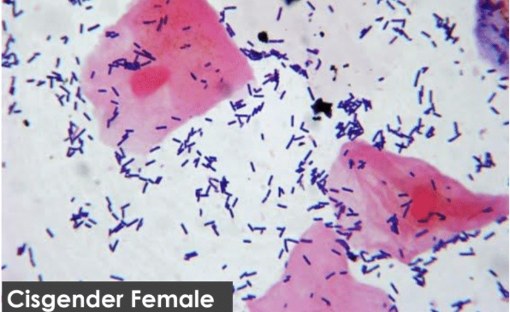
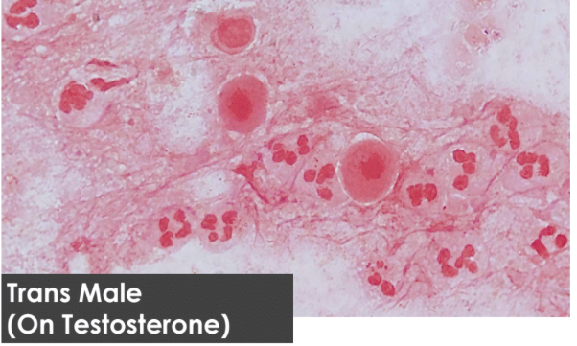
Testosterone-associated vaginitis
Testosterone induces hypo-estrogenic state
Dryness, dyspareunia, contact bleeding
PH change makes BV more likely
Inflammatory changes on microscopy
Responds to estrogen pessaries if acceptable
Muco-purulent discharge, swab -ve? Think desquamative vaginitis
Notes:
“and remember, not all pain/discharge is STI”
Superficial cells vs Parabasal or intermediate cells with neutrophils
Dose dependent impact of testosterone by inducing an hypo-estrogenic state – atrophy, increase in PH, vaginitis, urethritis, cervicitis
Can make more likely to develop BV
NOT an STI but an important differential diagnosis when a trans masculine person using testosterone presents with dyspareunia, and possibly contact bleeding – may be swab negative - could be treated with topical oestrogen, but care would be required to ensure that this was acceptable from a psychological perspective.
If presenting with muco-purulent discharge this might have progressed to desquamative vaginitis, an inflammatory condition that would also swab negative. This usually responds to topical Clindamycin and Hydrocortisone.

Slide 36
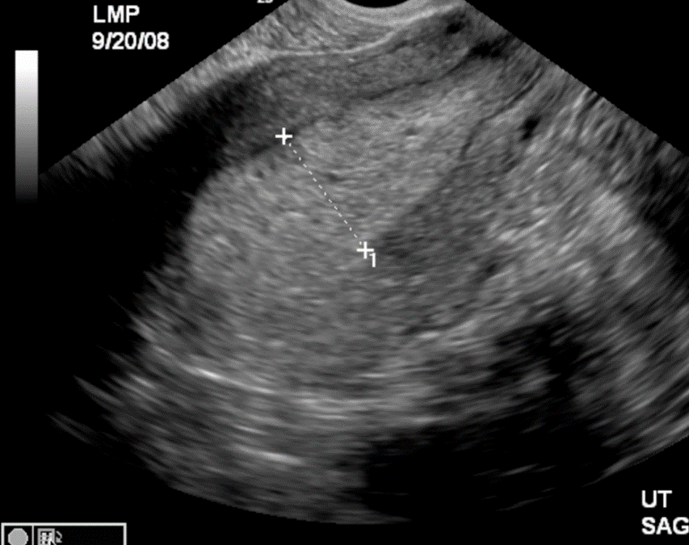
Consulting well : PV bleeding
Consider pregnancy/ectopic/miscarriage
Inadequate testosterone dosing > return of menstruation
Serum testosterone too high > aromatized to estrogen > endometrial hyperplasia > bleeding
Cervical pathology
STI swabs/urine

Slide 37

Contraception
Some trans masc. people use their vaginas
Testosterone no guarantee of anovulation
Conception most likely in first 6/12 months
Stop testosterone if pregnancy confirmed
Emergency contraception efficacious
Progesterone-based options, condoms
Slim-fitting condoms if genital shrinkage
Notes:
Condoms – failure rate 2% to 18%
Cross sex hormone therapy is not a contraceptive for trans women either…and some use their penis for sex
Discuss the need for contraception if relevant, eg some trans men use their vagina for sex. Some gay trans men exclusively date other trans men. Goes back to not assuming!
Also estrogen is not contraceptive for trans women who use their penis to penetrate someone capable to getting pregnant – and not just bisexuals or lesbians in this scenario, also heterosexual women if they sleep with trans men who use their vaginas.

Slide 38

Screening
Automatic call up based on gender marker
Cx sampling – increased pelvic floor tone, less vaginal secretions, atrophy
All people with breasts should attend breast screening
All exposed to testosterone should attend AAA screening
Current guidance is biennial USS endometrium for testosterone users
Use system alerts and contact relevant departments
https://phw.nhs.wales/services-and-teams/screening/abdominal-aortic-aneurysm-screening/information-resources/information-for-transgender/screening-information-for-people-who-are-transgender-non-binary-gender-diverse/
Notes:
Condoms – failure rate 2% to 18%
Cross sex hormone therapy is not a contraceptive for trans women either…and some use their penis for sex
Discuss the need for contraception if relevant, eg some trans men use their vagina for sex. Some gay trans men exclusively date other trans men. Goes back to not assuming!
Also estrogen is not contraceptive for trans women who use their penis to penetrate someone capable to getting pregnant – and not just bisexuals or lesbians in this scenario, also heterosexual women if they sleep with trans men who use their vaginas.

Slide 39


Role of the LES GP: long-term care
ES designed to accommodate long term maintenance prescribing
2 x 3/12 blood tests in target range, do one in 6/12 then annual testing begins
Annual bloods: FBC, LFT, lipids, prolactin, serum testosterone, serum oestradiol
Annual review for 30 minutes, to include:
- general wellbeing
- compliance/issues with HRT
- bloods review
- sexual health/contr./screening
- record BP, BMI and smoking status
Notes:
FOR ANTI-ANDROEGN ALONE:
In the absence of estrogen replacement, some patients may have unpleasant symptoms of hot flashes and low mood or energy. Long term full androgen blockade without hormone replacement in men who have undergone treatment for prostate cancer results in bone loss, and this effect would also be expected to occur in transgender individuals.
monitoring hormone levels to ensure suppressed gonadotropins (luteinizing hormone [LH] and follicle stimulating hormone [FSH]) levels may serve as a surrogate marker to indicate adequate sex hormone levels for maintaining bone density in such patients

Slide 40
Role of the LES GP: long-term care
For people on testosterone:
Long term testosterone 15-20 nmol/l
Vaginal atrophy & Cx screening
Endometrial scanning at 2 years & every 2 years
Chest awareness
AAA risk so should attend screening
Cardiovascular health
Notes:
FOR ANTI-ANDROEGN ALONE:
In the absence of estrogen replacement, some patients may have unpleasant symptoms of hot flashes and low mood or energy. Long term full androgen blockade without hormone replacement in men who have undergone treatment for prostate cancer results in bone loss, and this effect would also be expected to occur in transgender individuals.
monitoring hormone levels to ensure suppressed gonadotropins (luteinizing hormone [LH] and follicle stimulating hormone [FSH]) levels may serve as a surrogate marker to indicate adequate sex hormone levels for maintaining bone density in such patients

Slide 41
Role of the LES GP: long-term care
For people on estrogen/anti-androgen:
After puberty, long term estradiol target 350pmol/l
Breast awareness & screening
AAA risk – if prior male puberty, should be screened
Prostate health – reduce referral threshold if LUTS
Menopause plan – switch to topical estrogen
Notes:
FOR ANTI-ANDROEGN ALONE:
In the absence of estrogen replacement, some patients may have unpleasant symptoms of hot flashes and low mood or energy. Long term full androgen blockade without hormone replacement in men who have undergone treatment for prostate cancer results in bone loss, and this effect would also be expected to occur in transgender individuals.
monitoring hormone levels to ensure suppressed gonadotropins (luteinizing hormone [LH] and follicle stimulating hormone [FSH]) levels may serve as a surrogate marker to indicate adequate sex hormone levels for maintaining bone density in such patients

Slide 42



Learning resources : training guides

Slide 43




Signposting : patient support

Slide 44

Diolch

