Slide 1

Annual Accounts 2022/23
Catherine Phillips
Executive Director of Finance

Slide 2
Annual Accounts 2022/23
Financial Duties – Revenue Resource
The Welsh Government amended the financial performance duties applicable to LHB’s in 2014/2015 under the National Health Services Finance Act 2014
Two revenue financial duties now apply:
  A duty to ensure that its expenditure does not exceed the combined funding allocated to it over a period of 3 years
  A duty to prepare and obtain approval from the Welsh Ministers a plan (IMTP) which achieves the rolling 3 year position

Slide 3
Annual Accounts 2022/23
Financial Duties – Revenue Resource
The Integrated Medium Term Plan submitted for the period 2022-2025 did not include a balanced financial position and was not approved
Therefore, the UHB did not meet its statutory duty to have an approved financial plan for the period 2022-23 to 2024-25
In the absence of an approved Integrated Medium Term Plan, the LHB submitted a one year Operational Plan with a planned deficit of £26.9m deficit
Notes:
In the absence of an approved Integrated Medium Term Plan, the LHB submitted a one year Operational Plan with a planned deficit of £17.1m to Welsh Government in June 2022
Following the emergence of a number of in year cost pressures, the forecast was reviewed in November through the UHB’s governance structure, including the Finance Committee and Board and with Welsh Government colleagues in the mid-year review meeting . Following review, the forecast deficit was revised to a £26.9m deficit.

Slide 4
Annual Accounts 2021/22
Financial Duties – Revenue Resource
The operational plan (in the absence of an approved IMTP) was to deliver a year end position within a £26.9m deficit
The financial performance for the year, as contained in the accounts is a year-end deficit of £26.789m for 22/23
  The UHB had a surplus £0.090m in 20/21 and a surplus of £0.232m in 21/22
  This means that over the three-year period the combined deficit is £29.467m
  The UHB therefore, did not achieve its financial duty under either section 175(1) or 175(2a)

Slide 5
Annual Accounts 2022/23
Financial Targets – Capital Resource
The Health Board also has a duty to ensure capital expenditure remains with in the Welsh Government Capital Resource Allocation over the same three year period
In 22/23 the UHB successfully managed its capital programme and delivered a small surplus of £0.088m against its Capital Resource Limit of £55.410m
The UHB had a surplus of £0.104m in 20/21 and a surplus of £0.041m in 21/22 and against its Capital Resource Limit
This means that over the three-year period the combined surplus is £0.233m
Thus, the UHB met its financial duty to break-even against its Capital Resource Limit over the three years 20/21 to 22/23

Slide 6
Annual Accounts 2022/23
Performance – 20/21 to 22/23

Slide 7
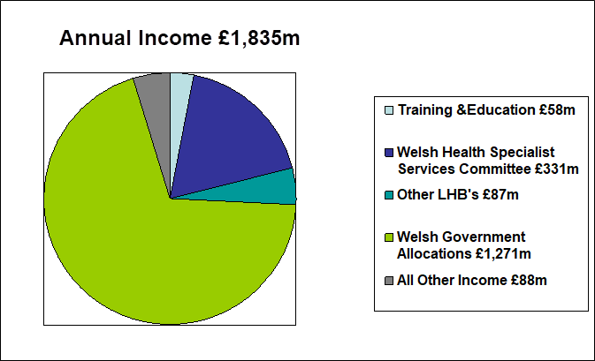
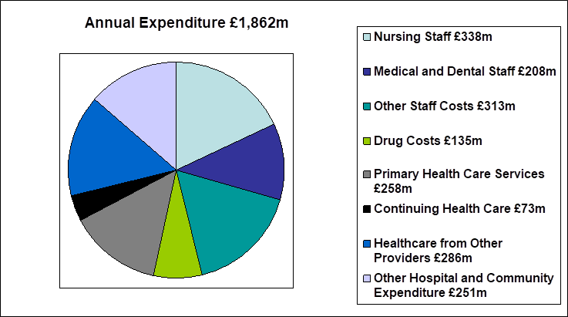
Annual Accounts 2022/23
Income and Expenditure

Slide 8
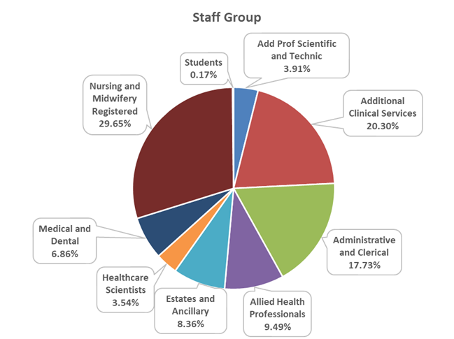
Annual Accounts 2022/23
Staff Numbers
Total Employees 17,221

Slide 9
Annual Accounts 2022/23
Assurance and Outcome
Assurance on the accuracy of the Annual Accounts can be taken by
The work and review carried out by the Audit and Assurance Committee throughout 22/23
The work completed by Audit Wales and summarised in their ISA 260 Report
The response given to the audit enquiries to those charged with governance, and management and the letter of representation provided to Audit Wales
The work carried out by Internal Audit and Counter Fraud throughout 22/23
The Accounts were approved by the Board on 27 July 2023
The Accounts were approved by the Auditor General for Wales on 28th July 2023
Audit Outcome
Overall an unqualified audit opinion was given on the 22/23 financial statements
The financial statements are fairly and appropriately presented without any identified exceptions and incompliance with accounting guidelines and free from material misstatement
Notes:
Assurance on the accuracy of the Annual Accounts can be taken by:
The work and review carried out by the Audit and Assurance Committee throughout 21/22 and the process it follows to verify and sign off the Annual Report and Accounts
Audit Committee Workshop 12th May 2022 - Draft Accounts Detailed Presentation
Final Draft Review and sign off 14th June 2022
The work completed by Audit Wales and presented to the Audit and Assurance Committee in their ISA 260 Report
The response given to the audit enquiries to those charged with governance, and management and the letter of representation that will be sent to Audit Wales;
Assurance can also given through the work carried out by internal audit and counter fraud and the opinion issued by the head of internal audit which is now included in the annual report

Slide 10
Financial Outlook 2023-24 – Revenue
We were unable to approve a balanced 3-year IMTP in our detailed submission to Welsh Government on 31st March
Given the scale of the delivery and financial challenge, the Health Board submitted a forecast deficit position of £88.4m (23/24). Our assessment was that £40m of this is a worsening of the underlying financial deficit and the remainder relates to unfunded exceptional cost inflation, the continued costs and consequences of the pandemic response.
Within our financial plan we have set a £32m recurrent cash-releasing savings target based on our estimation of what can be reliably delivered through stretching ambition and robust governance and oversight.
The current financial model using credible assumptions about future allocations, growth and activity indicates that we will need to achieve this level of recurrent savings in each of the next 5 years in order to achieve a sustainable, balanced position.

Slide 11
Annual Accounts 2021/22 and Financial Outlook 2022/23
Happy to receive questions

Slide 12
Additional Reference Info

Slide 13
Annual Accounts 2021/22
Capital Programme
The Health Board delivered £55.322m of Capital Schemes in 22/23
  £11.3m Genomics
  £12.6m Upgrading and maintaining the estate
  £6.0m National Imaging Programme
  £3.6m Robotics (IFRS 16)
  £3.3m Endoscopy
  £3.0m Whitchurch Road Surgery (IFRS 16)
  £3.0m Electrical Infrastructure
  £3.0m Refit
  £2.3m Maelfa Wellbeing Hub
  £1.9m Medical Equipment
  £1.6m Leases (IFRS 16)
  £1.5m Statutory Compliance
  £1.2m Covid Recovery Funding
  £1.0m IT
Notes:
The IT , estates and medical equipment include both discretionary and additional ‘major’ capital allocation

Slide 14
Annual Accounts 2022/23
Financial Outlook - Capital
23/24 Capital Resource Allocation (1/9/2023) - of £29.644m
£11.0m Discretionary Allocation
£7.2m Neuroradiology Equipment
£4.2m Efab (Infrastructure, Fire and Decarb)
£2.5m IRCF Well Being Hub Park View
£2.3m Endoscopy
£0.8m Rookwood
£0.6m Electrical Infrastructure
£1.0m other all Wales capital projects (inc. Digital Eyecare, CAVOC Theatres)
Should any additional funding opportunities arise, strategic priorities are identified for potential 2023/24 deliverable projects
Notes:
20/21 - £95.343m inc - £33.2m on lakeside surge in 20/21. (£15m discretionary)

